Slide 1
Accounting in Business
Chapter 1
Wild and Shaw
Fundamental Accounting Principles
25th Edition
Copyright ©2021 McGraw-Hill Education. All rights reserved. No reproduction or distribution without the prior written consent of McGraw-Hill Education.

Slide 2
Chapter 1 Learning Objectives
CONCEPTUAL
C1 Explain the importance of accounting and identify its users.
C2 Describe the importance of ethics and GAAP.
ANALYTICAL
A1 Define and interpret the accounting equation and each of its components.
PROCEDURAL
P1 Analyze business transactions using the accounting equation.
P2 Identify and prepare basic financial statements and explain how they interrelateمترابط .
© McGraw-Hill Education

Slide 3
Explain the importance of accounting and identify its users.
Learning Objective C1
© McGraw-Hill Education

Slide 4
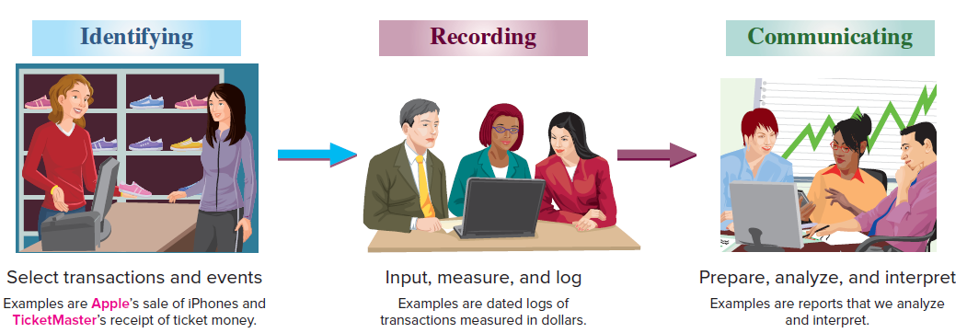
Importance of Accounting
Exhibit 1.1
Accounting is an information and measurement system that identifies, records, and communicates an organization’s business activities.
Learning Objective C1: Explain the importance of accounting and identify its users.
© McGraw-Hill Education
Notes:
Accounting is an information and measurement system that identifies, records, and communicates an organization’s business activities.
Identifying business activities requires that we select relevant transactions and events.
Recording business activities requires that we keep a chronological log of transactions and events measured in dollars.
Communicating business activities includes preparing accounting reports such as financial statements, which we analyze and interpret.
Recordkeeping, or bookkeeping, includes the recording of transactions and events and is just one part of accounting.

Slide 5
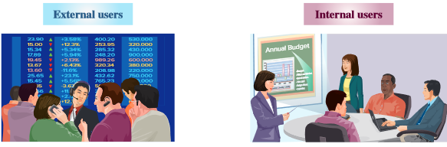
Users of Accounting Information
Accounting is called the language of business because it communicates data →to help people make better decisions. People using accounting information are divided into two groups: external users and internal users.
Shareholders
Lendersالمّقرض
External auditors
Nonmanagerial employees
Regulators المنظمين
Purchasing managers
Human resource managers
Production managers
Research and development managers
Marketing managers
Learning Objective C1: Explain the importance of accounting and identify its users.
© McGraw-Hill Education
Notes:
Accounting is called the language of business because all organizations set up an accounting information system to communicate data to help people make better decisions. Accounting serves many users who can be divided into two groups: external users and internal users.
External users of accounting information do not directly run the organization and have limited access to its accounting information.
المستخدمون الخارجيون للمعلومات المحاسبية لا يديرون المنظمة مباشرة ولديهم وصول محدود إلى معلوماتها المحاسبية.
Financial accounting is the area of accounting that serves external users. External users include shareholders (investors), lenders, external auditors, customers, nonmanagerial and nonexecutive employees, suppliers, regulators, and voters and government officials. External user’s business decisions depend on information that is reliable, relevant, and comparable.
المحاسبة المالية هي مجال المحاسبة الذي يخدم المستخدمين الخارجيين. يشمل المستخدمون الخارجيون المساهمين (المستثمرين) والمقرضين والمدققين الخارجيين والعملاء والموظفين غير الإداريين وغير التنفيذيين والموردين والمنظمين والناخبين والمسؤولين الحكوميين. تعتمد قرارات عمل المستخدم الخارجي على معلومات موثوقة وذات صلة وقابلة للمقارنة.
Internal users of accounting information directly manage the organization such as the chief executive officer (CEO), and all department managers. Internal reports are designed for the unique needs of managerial or executive employees. They use the information to help improve the efficiency and effectiveness of an organization.
يقوم المستخدمون الداخليون للمعلومات المحاسبية بإدارة المنظمة بشكل مباشر مثل الرئيس التنفيذي (CEO) وجميع مديري الأقسام. تم تصميم التقارير الداخلية لتلبية الاحتياجات الفريدة للموظفين الإداريين أو التنفيذيين. يستخدمون المعلومات للمساعدة في تحسين كفاءة وفعالية المنظمة.
Managerial accounting serves their decision-making needs. Examples of internal users include purchasing managers, human resource managers, production managers, distribution managers, marketing managers, service managers, and research and development managersز
. تخدم المحاسبة الإدارية احتياجات صنع القرار. تتضمن أمثلة المستخدمين الداخليين مديري المشتريات ومديري الموارد البشرية ومديري الإنتاج ومديري التوزيع ومديري التسويق ومديري الخدمات ومديري البحث والتطوير.

Slide 6
Artificial Intelligence and Data Analytics
Artificial Intelligence (AI) uses software and can be used to complete repetitive tasks such as entering invoices and transaction data.
Accountants are needed to help develop advanced AI systems and analyze reports and graphics.
Data analytics is a process of analyzing data to identify meaningful relations and trends.
Data visualization is a graphical presentation of data to help individuals make informed business decisions.
Learning Objective C1: Explain the importance of accounting and identify its users.
© McGraw-Hill Education
Notes:
Some estimate that AI could replace 40% of the workforce and is used for repetitive tasks including entering invoices and transaction data. Accountants are needed to help develop advanced AI systems and analyze reports and graphics.
يقدر البعض أن الذكاء الاصطناعي يمكن أن يحل محل 40 ٪ من القوى العاملة ويستخدم في المهام المتكررة بما في ذلك إدخال الفواتير وبيانات المعاملات. المحاسبون مطلوبون للمساعدة في تطوير أنظمة ذكاء اصطناعي متقدمة وتحليل التقارير والرسومات.
Data analytics and data visualization are highly sought top skills by employers.
Data analytics is the process of analyzing data to identify meaningful relations and trends.
Data visualization is a graphical presentation of data to help people understand their significance and help individuals make informed business decisions.
تعتبر تحليلات البيانات وتصور البيانات من أفضل المهارات المطلوبة من قبل أصحاب العمل.
. تحليلات البيانات هي عملية تحليل البيانات لتحديد العلاقات والاتجاهات ذات المغزى.
تصور البيانات هو عرض تقديمي بياني للبيانات لمساعدة الأشخاص على فهم أهميتها ومساعدة الأفراد على اتخاذ قرارات عمل مستنيرة.

Slide 7
Describe the importance of ethics and GAAP. generally accepted accounting principles
Learning Objective C2
© McGraw-Hill Education

Slide 8
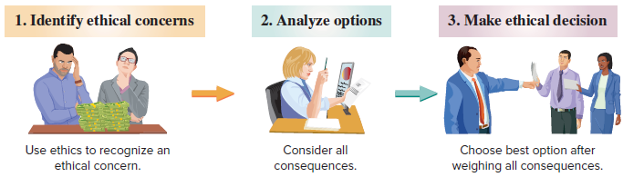
Ethics – A Key Concept
Exhibit 1.5
The goal of accounting is to provide useful information for decisions. For information to be useful, it must be trusted. This demands ethics in accounting. Ethics are beliefs that distinguish right from wrong. They are accepted standards of good and bad behavior.
Learning Objective C2: Describe the importance of ethics and GAAP.
© McGraw-Hill Education
Notes:
The goal of accounting is to provide useful information for decisions. For information to be useful, it must be trusted. This demands ethics in accounting. Ethics are beliefs that separate right from wrong. They are accepted standards of good and bad behavior.
When faced with an ethical concern, the first step is to recognize it as such. Next, we should analyze all of our options. Finally, we must choose the best option after weighing all the consequences.
عندما تواجه مشكلة أخلاقية ، فإن الخطوة الأولى هي الاعتراف بها على هذا النحو. بعد ذلك ، يجب علينا تحليل جميع خياراتنا. أخيرًا ، يجب أن نختار الخيار الأفضل بعد تقييم جميع العواقب
Good ethics are good business.
الأخلاق الحميدة هي عمل جيد.

Slide 9

Fraud Triangle
Three factors must exist for a person to commit fraud: opportunity, pressure, and rationalization.
Envisions a way to commit fraud with low risk of getting caught
Fails to see the criminal nature of the fraud or justifies the action
Must have some pressure to commit fraud, like unpaid bills
Learning Objective C2: Describe the importance of ethics and GAAP.
© McGraw-Hill Education
Notes:
The fraud triangle shows three factors must push a person to commit fraud: opportunity, pressure, and rationalization.
Opportunity. A person must be able to commit fraud with a low risk of getting caught.
Pressure, or incentive. A person must have pressure or have incentive to commit fraud. Examples are unpaid bills and addictions.
Rationalization, or attitude. A person justifies fraud or does not see its criminal nature. يبرر الشخص الاحتيال أو لا يرى طبيعته الإجرامية.
It is important to recognize that all three factors of the fraud triangle must usually exist for fraud to occur. The key to stopping fraud is to focus on prevention by using internal controls.
من المهم أن ندرك أن جميع العوامل الثلاثة لمثلث الاحتيال يجب أن تكون موجودة عادة لحدوث الاحتيال. مفتاح وقف الاحتيال هو التركيز على المنع باستخدام الضوابط الداخلية.
Internal controls are procedures to protect assets, ensure reliable accounting, promote efficiency, and uphold company policies. Examples are good records, physical controls, and independent reviews. It is less expensive and more effective to prevent fraud from happening than it is to try to detect the crime. By the time the fraud is discovered, the money is gone. Additionally, it is costly and time-consuming to investigate a fraud.
الضوابط الداخلية هي إجراءات لحماية الأصول ، وضمان المحاسبة الموثوقة ، وتعزيز الكفاءة ، ودعم سياسات الشركة. الأمثلة هي السجلات الجيدة ، والضوابط المادية ، والمراجعات المستقلة. إن منع حدوث الاحتيال أقل تكلفة وأكثر فاعلية من محاولة الكشف عن الجريمة. بحلول الوقت الذي تم اكتشاف الاحتيال ، ذهب المال. بالإضافة إلى ذلك ، فإن التحقيق في عملية احتيال أمر مكلف ويستغرق وقتًا طويلاً.
Auditors verify the effectiveness of internal controls. يتحقق المدققون من فعالية الضوابط الداخلية.

Slide 10
Generally Accepted Accounting Principles (GAAP)
Financial accounting is governed by concepts and rules known as generally accepted accounting principles (GAAP). GAAP wants information to have relevance and faithful representation.
Relevant information affects decisions
of users.
Faithful representation means information accurately reflects business results.
Learning Objective C2: Describe the importance of ethics and GAAP.
© McGraw-Hill Education
Notes:
Financial accounting is governed by concepts and rules known as generally accepted accounting principles (GAAP). GAAP wants information to have relevance and faithful representation. Relevant information affects decisions of users. Faithful representation means information accurately reflects the business results. تخضع المحاسبة المالية للمفاهيم والقواعد المعروفة باسم مبادئ المحاسبة المقبولة عمومًا
GAAP).
تريد مبادئ المحاسبة المقبولة عموماً أن تكون المعلومات ذات صلة بالموضوع وتمثيل مخلص. المعلومات ذات الصلة تؤثر على قرارات المستخدمين. يعني التمثيل الصادق أن المعلومات تعكس بدقة نتائج الأعمال.

Slide 11
Financial Accounting Standards Board (FASB)
The FASB sets GAAP.
Authority provided by the Securities and Exchange Commission (SEC).
The SEC is a U.S. government agency that oversees GAAP by companies that sell stock and debt to the public.
Learning Objective C2: Describe the importance of ethics and GAAP.
© McGraw-Hill Education
Notes:
The Financial Accounting Standards Board (FASB) is given the task of setting GAAP from the Securities and Exchange Commission (SEC). The SEC is a U.S. government agency that oversees proper use of GAAP by companies that sell stock and debt to the public. An audit examines whether financial statements are prepared using GAAP.
تم تكليف مجلس معايير المحاسبة المالية
(FASB) بمهمة وضع مبادئ المحاسبة المقبولة عموماً من هيئة الأوراق المالية والبورصات
(SEC).
لجنة الأوراق المالية والبورصات هي وكالة حكومية أمريكية تشرف على الاستخدام السليم لمبادئ المحاسبة المقبولة عموماً من قبل الشركات التي تبيع الأسهم والديون للجمهور. يفحص التدقيق ما إذا كانت البيانات المالية معدة باستخدام مبادئ المحاسبة المقبولة عموماً.

Slide 12
International Standards
In today’s global economy, there is increased demand by external users for comparability in accounting reports.
International Accounting Standards Board (IASB)
Issues International Financial Reporting Standards (IFRS).
Standards identify preferred accounting practices.
Standards are similar to, but sometimes different from U.S. GAAP.
FASB and IASB are working to reduce differences.
Learning Objective C2: Describe the importance of ethics and GAAP.
© McGraw-Hill Education
Notes:
In today’s global economy, there is increased demand by external users for comparability in accounting reports. The International Accounting Standards Board (IASB) is a group (consisting of individuals from many countries) that issues International Financial Reporting Standards (IFRS), which identify preferred accounting practices.
The FASB and IASB are working to reduce the differences between U.S. GAAP and IFRS.

Slide 13
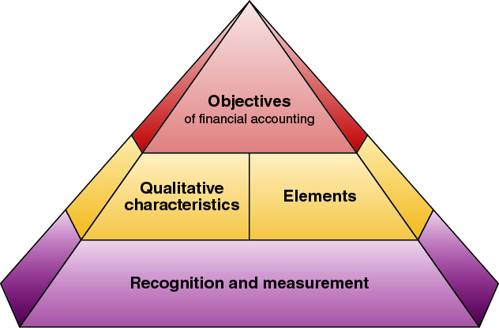
Conceptual Framework
Exhibit 1.6
Objectives – provide useful information to investors, creditors, and others.
Qualitative characteristics – information has relevance and faithful representation.
Elements – defines items in financial statements.
Recognition and measurement – criteria for an item to be recognized as an element and how to measure it.
Learning Objective C2: Describe the importance of ethics and GAAP.
© McGraw-Hill Education
Notes:
The FASB framework consists of the following:
Objectives—to provide information useful to investors, creditors, and others.
Qualitative Characteristics—to require information that has relevance and faithful representation.
Elements—to define items in financial statements.
Recognition and Measurement—to set criteria that an item must meet for it to be recognized as an element; and how to measure that element.

Slide 14
Accounting Principles
Measurement Principle
(Cost Principle)
Accounting information is based on actual cost. Actual cost is considered objective.
Revenue Recognition Principle
Recognize revenue when goods or services are provided to customers and
at an amount expected to be received from the customer.
Expense Recognition Principle
(Matching Principle)
A company records its expenses incurred to generate the revenue reported.
Full Disclosure Principle
A company reports the details behind financial statements that would impact users’ decisions in the notes to the financial statements.
Learning Objective C2: Describe the importance of ethics and GAAP.
© McGraw-Hill Education
Notes:
There are four general principles.
The measurement principle, also called the cost principle, usually means that accounting information is based on actual cost. Cost is measured on a cash or equal-to-cash basis. This means if cash is given for a service, its cost is measured as the amount of cash paid. Information based on cost is considered objective. Objectivity means that information is supported by independent, unbiased evidence.
Two concepts are important to the revenue recognition principle:
Revenue is recognized when the services are performed or the goods are provided to the buyer and
(2) Revenue is recognized at the amount expected to be received from the customer. The amount received is usually in cash, but it is also common to receive a customer’s promise to pay at a future date, called credit sales.
The expense recognition principle, also called the matching principle, states that the company records expenses incurred to generate the revenue reported. The principles of matching and revenue recognition are key to modern accounting.
The full disclosure principle states that a company reports the details that would impact users’ decisions. Most of the details are reported in the footnotes to the financial statements.

Slide 15
Accounting Assumptions
Going-Concern Assumption
The business is presumed to continue operating instead of being closed or sold.
Monetary Unit Assumption
Transactions and events are expressed in monetary, or
money, units.
Time Period Assumption
The life of a company
can be divided into time periods,
such as months and years.
Business Entity Assumption
A business is accounted for separately from other business entities, including its owner.
Learning Objective C2: Describe the importance of ethics and GAAP.
© McGraw-Hill Education
Notes:
Now we will look at four fundamental assumptions of accounting.
The going-concern assumption states that, accounting information presumes that the business will continue operating instead of being closed or sold.
The monetary unit assumption tells us that we will only record accounting information that can be expressed in monetary units, usually dollars in the United States.
The time period assumption presumes that the life of a company can be divided into time periods such as months and years, and that useful reports can be prepared for those periods.
Finally, the business entity assumption tells us that a business is accounted for separately from other business entities and its owner.

Slide 16
Define and interpret the accounting equation and each of its components.
Learning Objective A1
© McGraw-Hill Education

Slide 17
Business Transactions and Accounting
The Accounting Equation
=
+
Assets
Liabilities
Equity
Expanded Accounting Equation:
Net Income
Learning Objective A1: Define and interpret the accounting equation and each of its components.
© McGraw-Hill Education
Notes:
Accounting reflects two basic aspects of a company: what it owns and what it owes.
Assets are resources a company owns or controls. These resources are expected to yield future benefits. Examples are cash, accounts receivable, supplies, equipment, land, and web servers for an online services company. The term receivable refers to an asset that promises a future inflow of resources. A company that provides a service or product on credit is said to have an account receivable from that customer. الأصول هي الموارد التي تمتلكها الشركة أو تتحكم فيها. ومن المتوقع أن تعود هذه الموارد بفوائد مستقبلية. ومن الأمثلة على ذلك النقد وحسابات القبض والإمدادات والمعدات والأرض وخوادم الويب لشركة خدمات عبر الإنترنت. يشير مصطلح "مستحق" إلى أصل يعد بتدفق مستقبلي للموارد. يقال إن الشركة التي تقدم خدمة أو منتجًا بالائتمان لديها حساب مستحق من ذلك العميل.
Liabilities are creditors’ claims on assets. These claims reflect company obligations to provide assets, products, or services to others. The term payable refers to a liability that promises a future outflow of resources. Examples are wages payable to workers, accounts payable to suppliers, and notes payable to banks.
المطلوبات هي مطالبات الدائنين على الأصول. تعكس هذه المطالبات التزامات الشركة بتوفير الأصول أو المنتجات أو الخدمات للآخرين. يشير مصطلح الدفع إلى التزام يعد بتدفق خارجي للموارد في المستقبل. الأمثلة هي الأجور المستحقة للعمال ، والحسابات المستحقة الدفع للموردين ، وأوراق الدفع للبنوك.
Equity is the owner’s claim on assets, and is equal to assets minus liabilities. This is the reason equity is also called net assets or residual equity. Equity is increased by owner investments and from revenues. It is decreased by owner withdrawals and expenses. Equity (also called net assets or residual equity) refers to the claims of its owner(s). Together, liabilities and equity are the source of funds to acquire assets.
حقوق الملكية هي مطالبة المالك بالأصول ، وتساوي الأصول مطروحًا منها الخصوم. هذا هو سبب تسمية حقوق الملكية أيضًا بصافي الأصول أو حقوق الملكية المتبقية. يتم زيادة حقوق الملكية من خلال استثمارات المالك ومن الإيرادات. يتم تخفيضه من خلال سحوبات المالك والنفقات. تشير حقوق الملكية (وتسمى أيضًا صافي الأصول أو حقوق الملكية المتبقية) إلى مطالبات مالكها (مالكيها). تعد المطلوبات وحقوق الملكية معًا مصدر الأموال للحصول على الأصول
Equity has four parts: owner, capital; owner, withdrawals; revenues and expenses.
Owner, Capital reflects inflows of cash and other net assets from owner contributions which increase equity.
Owner, Withdrawals are outflows of cash and other assets to owners for personal use which reduce equity.
Revenues increase equity from sales of products and services to customers.
Expenses decrease equity from costs of providing products and services to customers.

Slide 18
The Accounting Equation
Assets | = | Liabilities | + | Owner's Equity
Basic Accounting Equation
Provides underlying framework for recording and summarizing economic events
Assets are claimed by either creditors or owners
If a business is liquidated, claims of creditors must be paid before ownership claims
LO 3

Slide 19
The Accounting Equation
Assets | = | Liabilities | + | Owner's Equity
Assets
Resources a business owns
Provide future services or benefits
Cash, Supplies, Equipment, etc.
LO 3

Slide 20
The Accounting Equation
Assets | = | Liabilities | + | Owner's Equity
Liabilities
Claims against assets (debts and obligations)
Creditors (party to whom money is owed)
Accounts Payable, Notes Payable, Salaries and Wages Payable, etc.
LO 3

Slide 21
The Accounting Equation
Assets | = | Liabilities | + | Owner's Equity
Owner’s Equity
Ownership claim on total assets
Referred to as residual equity
Investment by owners and revenues (+)
Drawings and expenses (-)
LO 3

Slide 22
The Accounting Equation
ILLUSTRATION 1.6
Expanded accounting equation
Equation | Assets | = | Liabilities | + | Owner's Equity
Expanded Equation | Assets | = | Liabilities | + | Owner's Capital | - | Owner's Drawings | + | Revenues | - | Expenses
Increase in Owner’s Equity
Investment by Owner. Assets the owner puts into the business
Revenues. Resulting from sale of goods or performance of services in normal course of business
LO 3

Slide 23
The Accounting Equation
Equation | Assets | = | Liabilities | + | Owner's Equity
Expanded Equation | Assets | = | Liabilities | + | Owner's Capital | - | Owner's Drawings | + | Revenues | - | Expenses
Decrease in Owner’s Equity
Drawings. A withdraw of cash or other assets for personal use
Expenses. Cost of assets consumed or services used in the process of earning revenue
LO 3

Slide 24
Analyze business transactions using the accounting equation.
Learning Objective P1
© McGraw-Hill Education

Slide 25
Transaction 1: Investment by Owner
Chas Taylor invests $30,000 cash in a new business named FastForward. FastForward is a proprietorship.
The accounts involved are:
(1) Cash (asset)
(2) C. Taylor, Capital (equity)
Learning Objective P1: Analyze business transactions using the accounting equation.
© McGraw-Hill Education
Notes:
Let’s look at the identification and recording of business transactions. We can begin by analyzing a transaction where Chas Taylor forms a consulting business named FastForward. Taylor invests $30,000 cash in the new company which is set up as a proprietorship.
First, we have to identify the assets, liability, or equity accounts involved in this transaction. We can see that the Cash account will increase by $30,000 and the equity account, C. Taylor, Capital, will also increase by $30,000.
Let’s see how the books of the company will appear after we record this transaction.

Slide 26
Accounting Equation 1
Chas Taylor invests $30,000 cash to start the business, FastForward.
Learning Objective P1: Analyze business transactions using the accounting equation.
© McGraw-Hill Education
Notes:
Here we show the increase in the asset account, Cash, and the increase in the equity account, C. Taylor, Capital, by $30,000. Our basic accounting equation is in balance. Assets have a total balance of $30,000 and liabilities plus equity have a total balance of $30,000. Let’s move on to another transaction.

Slide 27
Transaction 2: Purchase Supplies for Cash
FastFoward purchased supplies paying $2,500 cash.
The accounts involved are:
(1) Cash (asset)
(2) Supplies (asset)
Learning Objective P1: Analyze business transactions using the accounting equation.
© McGraw-Hill Education
Notes:
In this transaction, the company purchases supplies of Nike and Adidas footwear by paying $2,500 cash. The asset account, cash, will decrease by the $2,500 cash paid. The asset account, supplies, will increase by $2,500, the cost of the supplies. In this transaction we are giving up one asset, cash, and receiving another asset, supplies. Let’s look at our books after this transaction is recorded.

Slide 28
Accounting Equation 2
FastFoward purchased supplies paying $2,500 cash.
Accounting Equation must remain in balance!!
Learning Objective P1: Analyze business transactions using the accounting equation.
© McGraw-Hill Education
Notes:
We can see the decrease in cash and the increase in supplies. The total assets are still equal to $30,000 but are divided between cash and supplies. There is no change on the liabilities plus equity section of our books.

Slide 29
Transaction 3: Purchase Equipment for Cash
FastForward purchased equipment for $26,000 cash.
The accounts involved are:
(1) Cash (asset)
(2) Equipment (asset)
Learning Objective P1: Analyze business transactions using the accounting equation.
© McGraw-Hill Education
Notes:
This transaction is similar to the last one we recorded. Here we purchase equipment by paying $26,000 cash. The asset account, cash, will decrease by $26,000. The asset account, equipment, will increase by $26,000. Once again, we are exchanging one asset for another. Can you predict what our books will look like after recording this transaction?

Slide 30
Accounting Equation 3
Purchased equipment for $26,000 cash.
Accounting Equation still remains in balance!!
Learning Objective P1: Analyze business transactions using the accounting equation.
© McGraw-Hill Education
Notes:
Cash is reduced by $26,000 and equipment is increased by $26,000. The balance in our cash account is now $1,500. We have a current balance in supplies of $2,500, and equipment of $26,000. The three asset accounts total $30,000. Once again, there has been no change in the liabilities plus equity side of the equation.

Slide 31
Transaction 4: Purchase Supplies on Credit
FastFoward purchased supplies of $7,100 on credit.
The accounts involved are:
(1) Supplies (asset)
(2) Accounts Payable (liability)
Learning Objective P1: Analyze business transactions using the accounting equation.
© McGraw-Hill Education
Notes:
In this transaction, the company purchases supplies of $7,100 on credit. We do not pay cash, but agree to pay off the account at some point in the future. The asset account, Supplies, increases by $7,100 and the liability account, accounts payable, increases by $7,100 as well. Let’s see what our books look like now.

Slide 32
Accounting Equation 4
FastForward purchased supplies of $7,100 on credit.
Accounting Equation still remains in balance!!
Learning Objective P1: Analyze business transactions using the accounting equation.
© McGraw-Hill Education
Notes:
You can see the balance in the cash, supplies, and equipment accounts. The total on the asset side of the equation is $37,100. We acquired the assets without paying cash. If you use a credit card to purchase gas for your car, you receive an asset, gas, and incur an account payable to the credit card company. The balance in the liabilities accounts is now $7,100, and the C. Taylor, Capital account balance is still $30,000.

Slide 33
Transaction 5: Provide Services for Cash
FastForward provided consulting services to a customer and received $4,200 cash immediately.
The accounts involved are:
(1) Cash (asset)
(2) Revenues (equity)
Learning Objective P1: Analyze business transactions using the accounting equation.
© McGraw-Hill Education
Notes:
The company rendered consulting services to a customer receiving $4,200 cash in full payment. The asset account, cash, will increase by $4,200. The equity account, revenues, will also increase by the same amount. Let’s look at our expanded book balances.

Slide 34
Accounting Equation 5
FastForward provided consulting services to a customer and received $4,200 cash immediately.
Learning Objective P1: Analyze business transactions using the accounting equation.
© McGraw-Hill Education
Notes:
You see that our cash account increases by $4,200, to a current balance of $5,700. Total assets amount to $41,300. The revenue account also increased by $4,200. Recall that from our expanded accounting equation that revenues increase equity and expenses decrease equity. The total of our liabilities plus equity is now $41,300.

Slide 35
Transactions 6 and 7: Payment of Expenses in Cash
FastForward paid rent of $1,000 and salaries of $700 to employees.
The accounts involved are:
(1) Cash (asset)
(2) Rent expense (equity)
(3) Salaries expense (equity)
Remember that the balance in the Expense accounts actually increase.
But, total Equity decreases, because expenses reduce equity.
Learning Objective P1: Analyze business transactions using the accounting equation.
© McGraw-Hill Education
Notes:
The company paid cash rent of $1,000 and cash salaries of $700 to employees. The asset account, cash, decreases by $1,700 dollars. The equity account, rent expense increases by $1,000 and salaries expense increases by $700. Remember, an increase in an expense account will decrease total equity. Do you think you can get this transaction recorded properly in our books?

Slide 36
Accounting Equation 6 and 7
FastForward paid rent of $1,000 and salaries of $700 to employees.
Remember that expenses decrease equity.
Learning Objective P1: Analyze business transactions using the accounting equation.
© McGraw-Hill Education
Notes:
How did you do? You got the decrease in the cash account, but did you remember to show the increase in expenses as a decrease in total equity. Our expanded equation is getting to look more and more complicated. Don’t worry, practice will help you fully understand the recording of these and similar transactions. Our books are still in balance.

Slide 37
Transaction 8: Provide Services and Facilities for Credit
The accounts involved are:
(1) Accounts receivable (asset)
(2) Consulting revenue (equity)
(3) Rental revenue (equity)
FastForward provided consulting services of $1,600 and rents facilities for $300 to a customer for credit.
Learning Objective P1: Analyze business transactions using the accounting equation.
© McGraw-Hill Education
Notes:
The company provided consulting services of $1,600 and rented its test facilities for $300 to a customer. The asset account, Accounts receivable, will increase by $1,900. The equity account, Consulting revenue will increase by $1,600 and the equity account Rental Revenue, will also increase by the $300. Let’s look at our expanded book balances.

Slide 38
Accounting Equation 8
FastForward provided consulting services of $1,600 and rents facilities for $300 to a customer for credit.
Learning Objective P1: Analyze business transactions using the accounting equation.
© McGraw-Hill Education
Notes:
Our expanded equation is getting to look more and more complicated. Don’t worry, practice will help you fully understand the recording of these and similar transactions. Our books are still in balance.

Slide 39
Transaction 9: Receipt of Cash from Accounts Receivable
The accounts involved are:
(1) Cash (asset)
(2) Accounts receivable (asset)
Client in transaction 8 pays $1,900 for consulting services.
Learning Objective P1: Analyze business transactions using the accounting equation.
© McGraw-Hill Education
Notes:
The client in transaction 8 pays $1,900 10 days after it is billed for consulting services.

Slide 40
Accounting Equation 9
Client in transaction 8 pays $1,900 for consulting services.
Learning Objective P1: Analyze business transactions using the accounting equation.
© McGraw-Hill Education
Notes:
The client in transaction 8 pays $1,900 10 days after it is billed for consulting services. The total amount of assets remains the same, and liabilities and equity remain the same as well.

Slide 41
Transaction 10: Payment of Accounts Payable
The accounts involved are:
(1) Cash (asset)
(2) Accounts payable (liability)
FastForward pays $900 as partial payment for supplies purchased in transaction 4.
Learning Objective P1: Analyze business transactions using the accounting equation.
© McGraw-Hill Education
Notes:
FastForward pays $900 as partial payment for its earlier purchase of supplies purchased in transaction 4 leaving $6,200 balance unpaid.

Slide 42
Accounting Equation 10
FastForward pays $900 as partial payment for supplies purchased in transaction 4.
Learning Objective P1: Analyze business transactions using the accounting equation.
© McGraw-Hill Education
Notes:
FastForward pays $900 as partial payment for its earlier purchase of supplies purchased in transaction 4 leaving $6,200 balance unpaid in its accounts payable account.

Slide 43
Transaction 11: Withdrawal of Cash by Owner
The accounts involved are:
(1) Cash (asset)
(2) C. Taylor, Withdrawals (equity)
Owner withdraws $200 cash for personal use.
Remember that the Withdrawals account actually increases (just like our Expense accounts).
But, total Equity decreases because withdrawals cause equity to go down!!
Learning Objective P1: Analyze business transactions using the accounting equation.
© McGraw-Hill Education
Notes:
The owner of FastForward withdraws $200 cash. The company’s Cash account decreases by $200. The equity account, Withdrawals, increases by $200. Once again, refer back to the expanded accounting equation and you will see that withdrawals decrease total equity.

Slide 44
Accounting Equation 11
Owner withdraws $200 cash for personal use.
Learning Objective P1: Analyze business transactions using the accounting equation.
© McGraw-Hill Education
Notes:
The company’s Cash account decreased by $200. The equity account, C. Taylor, Withdrawals, increased by $200.

Slide 45
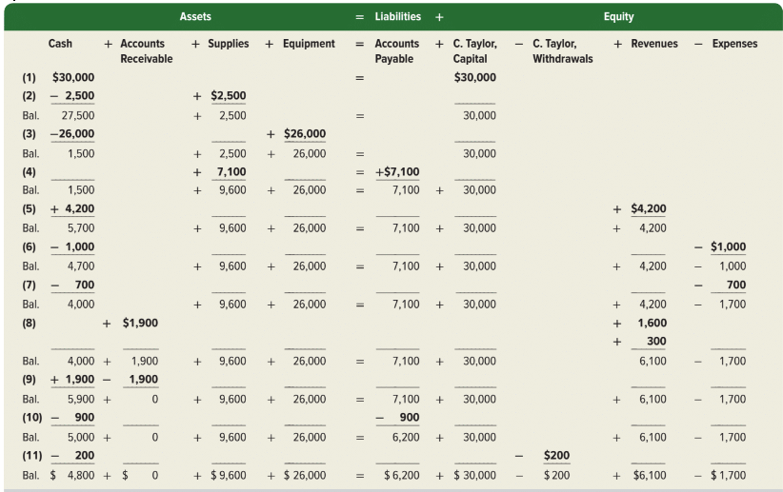
Summary of Transactions
Exhibit 1.9
Learning Objective P1: Analyze business transactions using the accounting equation.
© McGraw-Hill Education
Notes:
Exhibit 1.9 shows the effects of all 11 transactions using the accounting equation.

Slide 46
End of Lecture 1 Thank you

